Slide 1


Purchase Requests Specific Functionalities
Yoel Kortick. Senior Librarian
https://1001libraries.files.wordpress.com/2015/04/seoul-reading-room.jpg

Slide 2
Introduction
This presentation will focus primarily on specific features regarding the Purchase request functionality.
For a workflow-oriented presentation see Acquisitions - Purchase Requests in Alma.pptx
For a general overview of working with Purchase Requests see:
https://knowledge.exlibrisgroup.com/Alma/Product_Documentation/010Alma_Online_Help_(English)/020Acquisitions/020Purchasing/020Creating_PO_Lines/070Patron_Purchase_Requests

Slide 3
Topics
Staff roles - assigning owning library
Staff roles – handling purchase requests
Determination of purchase request type
Purchase request "Use existing record"
Purchase request "Use existing record" - option 1
Purchase request "Use existing record" - option 2
Purchase request task list
Purchase request Primo form customization
Purchase request deletion from Primo library card
User level "Purchase request library"
Relink Purchase Request to different record
Define Purchase Request match method

Slide 4
Staff roles - assigning owning library
Three roles exist in Alma specifically regarding purchase requests:
Purchase Request Manager = Manages purchase requests operations including edit, add fund and/or vendor, approve, reject, assign or reassign purchase requests.
Purchase Request Operator = Manages purchase requests operations including edit, add fund and/or vendor, approve, reject. Cannot assign or reassign purchase requests.
Purchase Request Operator Extended = Can delete purchase requests

Slide 5
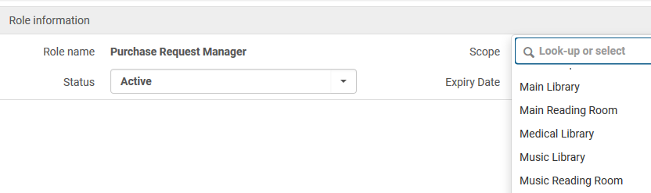
Staff roles - assigning owning library
All three roles can have a scope on the level of the institution or of a specific library.
For example:

Slide 6
Staff roles - assigning owning library
The effect of using a scope for these roles is:
A staff user can see in the list of purchase requests only those requests with either no owning library or the same owning library as his scope
A staff user can attribute an owning library to a purchase request only for libraries which match his scope
The purchase request manager can assign or reassign purchase requests only if they are owned by no library or by a library which matches his scope. They can then only assign them to other users which have a role scope which matches the purchase request scope.

Slide 7
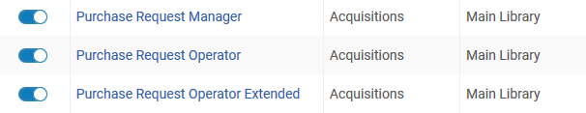
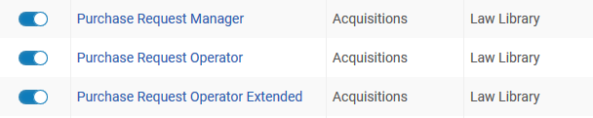
Staff roles - assigning owning library
For example user Thomas Safransky has all three purchase request roles on the scope of the Main Library
For example user James Meydansky has all three purchase request roles on the scope of the Law Library

Slide 8
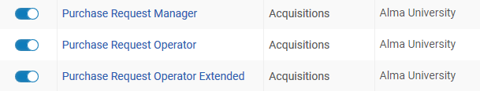
Staff roles - assigning owning library
User Simon Persky has all three purchase request roles on the scope of the Institution

Slide 9
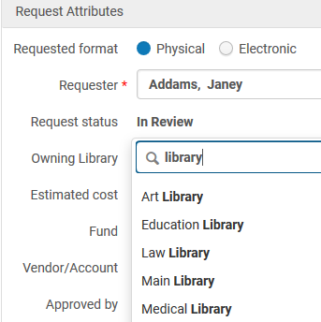
Staff roles - assigning owning library
User Simon Persky Can assign any owning library to a purchase request

Slide 10
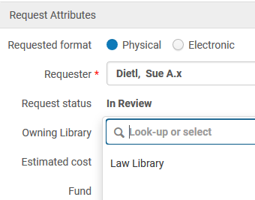
Staff roles - assigning owning library
User James Meydansky can assign only the Law library to a purchase request

Slide 11
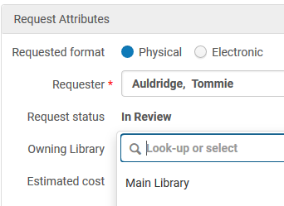
Staff roles - assigning owning library
User Thomas Safransky can assign only the Main library to a purchase request

Slide 12
Topics
Staff roles - assigning owning library
Staff roles – handling purchase requests
Determination of purchase request type
Purchase request "Use existing record"
Purchase request "Use existing record" - option 1
Purchase request "Use existing record" - option 2
Purchase request task list
Purchase request Primo form customization
Purchase request deletion from Primo library card
User level "Purchase request library"
Relink Purchase Request to different record
Define Purchase Request match method

Slide 13
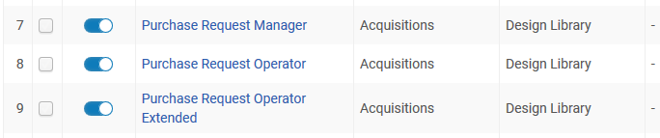
Staff roles – handling purchase requests
The three roles also determine which purchase requests can be viewed in the lists and to whom they can be assigned.
For example user Mary Ann Barlow has the three roles on the level of the design library

Slide 14
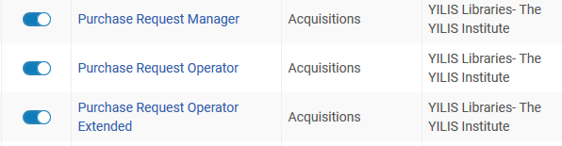
Staff roles – handling purchase requests
User Thomas Safransky has the three roles on the level of the institution

Slide 15
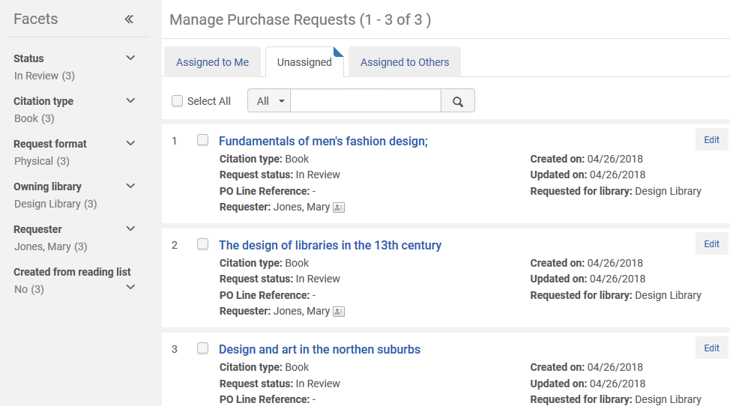
Staff roles – handling purchase requests
User Mary Ann Barlow sees purchase requests for design and fine arts libraries (if there are purchase requests for them)

Slide 16
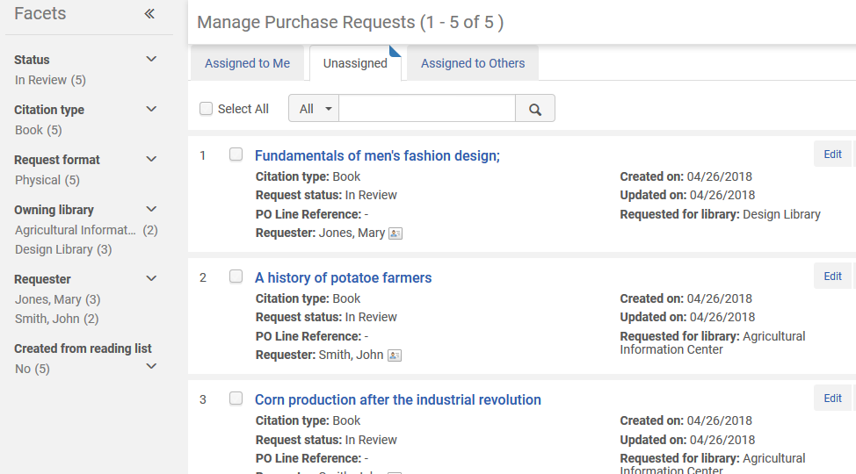
Staff roles – handling purchase requests
User Thomas Safransky sees purchase requests for all libraries

Slide 17
Topics
Staff roles - assigning owning library
Staff roles – handling purchase requests
Determination of purchase request type
Purchase request "Use existing record"
Purchase request "Use existing record" - option 1
Purchase request "Use existing record" - option 2
Purchase request task list
Purchase request Primo form customization
Purchase request deletion from Primo library card
User level "Purchase request library"
Relink Purchase Request to different record
Define Purchase Request match method

Slide 18
Determination of purchase request type
When creating a purchase request the type of request is determined as follows:
The citation type for a searched item comes from the ISBN or ISSN.
  If there is an ISBN number, the citation type is Book.
  If there is an ISSN number, the citation type is Journal.
If neither number is present, the citation type is the type that was chosen when the purchase request was created.

Slide 19
Determination of purchase request type
As an example of how this is applied
A purchase request of type Journal is created with no ISSN
The MD Editor is used to edit the record which is linked to the purchase request and an ISBN is added
The purchase request is then edited and saved
After the purchase request is saved, the citation type of the purchase request becomes Book (because an ISBN is present).

Slide 20
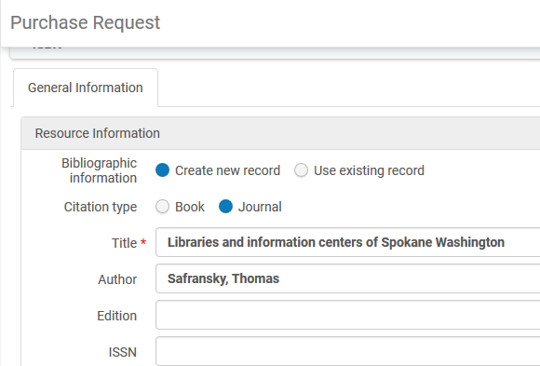
Determination of purchase request type
A purchase request of type Journal is created with no ISSN

Slide 21
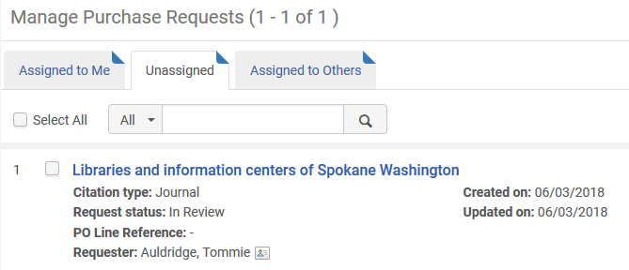
Determination of purchase request type
The type is Journal

Slide 22
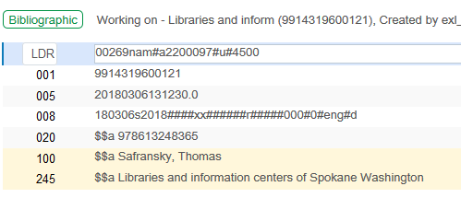
Determination of purchase request type
The bibliographic record is edited in the metadata editor and the 020 is added

Slide 23
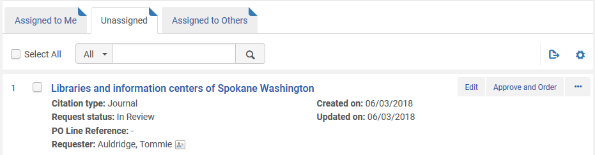
Determination of purchase request type
The type is still Journal but now we will edit and save

Slide 24
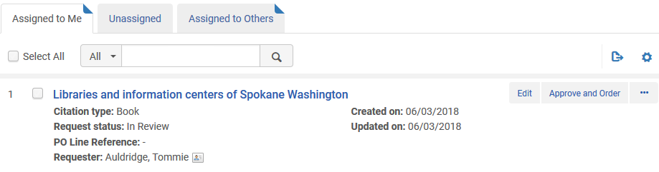
Determination of purchase request type
Now the citation type is book

Slide 25
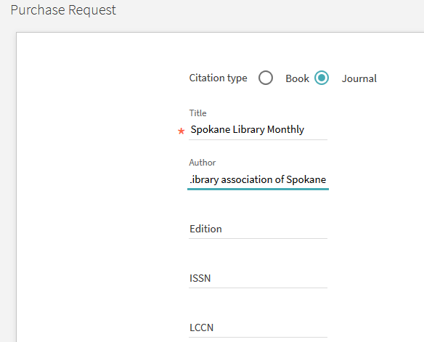
Determination of purchase request type
Here an end user creates a purchase request in Primo.
They choose type "Journal" but do not include an ISSN.

Slide 26
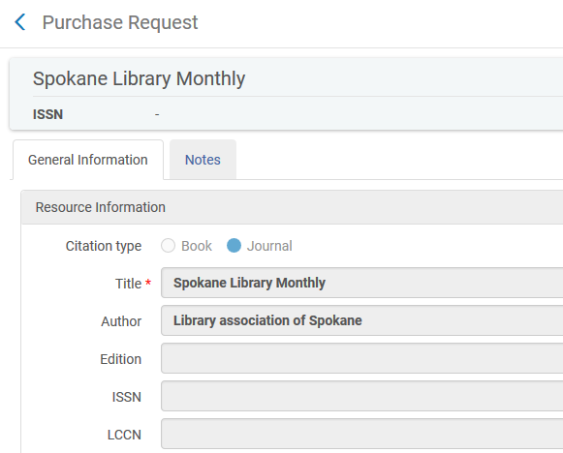
Determination of purchase request type
The type is "Journal" because even though there is no ISSN the user chose type "Journal"

Slide 27
Determination of purchase request type
Note as well that after a purchase request is created the bibliographic information can be edited only from the metadata editor. It cannot be edited in the purchase request form, as all bibliographic fields are greyed out.

Slide 28
Topics
Staff roles - assigning owning library
Staff roles – handling purchase requests
Determination of purchase request type
Purchase request "Use existing record"
Purchase request "Use existing record" - option 1
Purchase request "Use existing record" - option 2
Purchase request task list
Purchase request Primo form customization
Purchase request deletion from Primo library card
User level "Purchase request library"
Relink Purchase Request to different record
Define Purchase Request match method

Slide 29
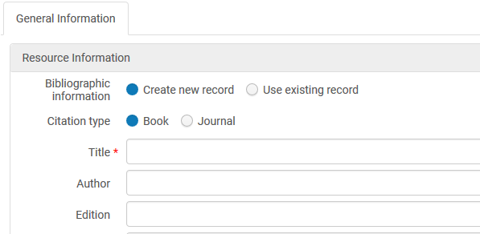
Purchase request "Use existing record"
At the point of creating a purchase request in Alma the staff user has two options:
Create New Record
Use Existing Record

Slide 30
Purchase request "Use existing record"
If the staff user chooses "Use existing record" then:
A "quick pick" list is available for the Title field while the other item fields are restricted.
After searching for and choosing an existing record the staff user can either
Create the purchase request from this record.
Use this record as a "template" by switching to radio button "Create new record". In this case the bibliographic fields will become editable.

Slide 31
Purchase request "Use existing record"
Option 1 is useful is the staff user wishes to order another copy or a different format of an existing resource
Option 2 is useful if the staff user wishes to create a new purchase request for a bibliographic record which is similar to an existing record.

Slide 32
Topics
Staff roles - assigning owning library
Staff roles – handling purchase requests
Determination of purchase request type
Purchase request "Use existing record"
Purchase request "Use existing record" - option 1
Purchase request "Use existing record" - option 2
Purchase request task list
Purchase request Primo form customization
Purchase request deletion from Primo library card
User level "Purchase request library"
Relink Purchase Request to different record
Define Purchase Request match method

Slide 33
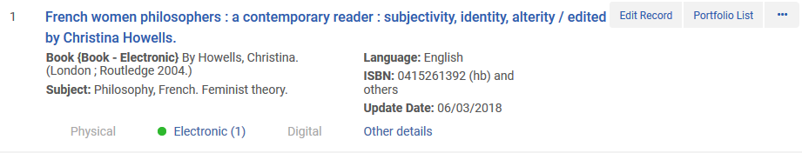
Purchase request "Use existing record"
Option 1 example
The institution has an E Book for "French women philosophers".
Now someone wants a physical version.
The record already exists in the repository

Slide 34
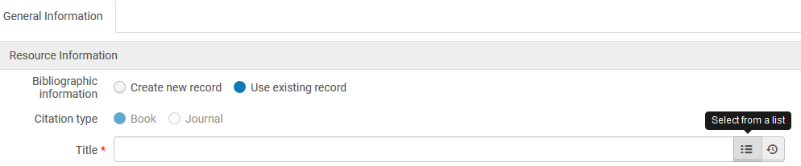
Purchase request "Use existing record"
Option 1 example
The staff user creates a new purchase request, select "use existing record" and clicks the pick list icon.

Slide 35
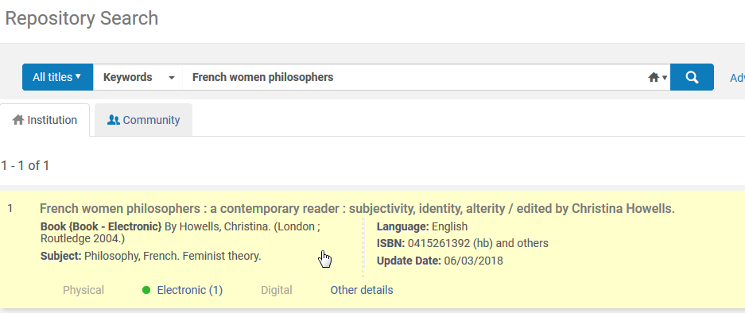
Purchase request "Use existing record"
Option 1 example
Now search for the record and select it

Slide 36
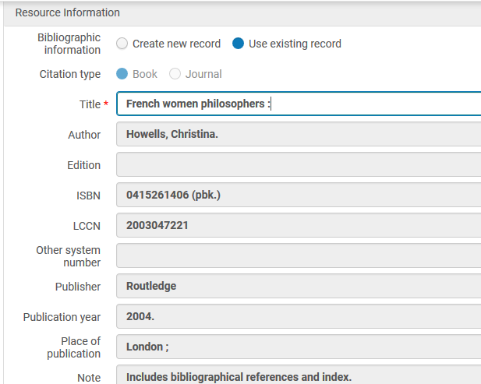
Purchase request "Use existing record"
Option 1 example
The bibliographic information gets filled in for the purchase request

Slide 37
Topics
Staff roles - assigning owning library
Staff roles – handling purchase requests
Determination of purchase request type
Purchase request "Use existing record"
Purchase request "Use existing record" - option 1
Purchase request "Use existing record" - option 2
Purchase request task list
Purchase request Primo form customization
Purchase request deletion from Primo library card
User level "Purchase request library"
Relink Purchase Request to different record
Define Purchase Request match method

Slide 38
Purchase request "Use existing record"
Option 2 example
The institution already has title "Twentieth-century French women novelists" from the series "Twayne's world authors series. French literature"
Now they want to order title "Nineteenth-century French women novelists" from the same series "Twayne's world authors series. French literature"
Instead of entering the information from scratch they will search for it using "Use existing record", select it, then switch to radio button "Create new record" and change relevant fields

Slide 39
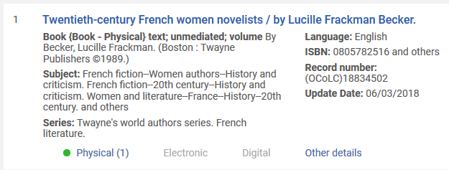
Purchase request "Use existing record"
Option 2 example
The "similar" record already exists

Slide 40
Purchase request "Use existing record"
Option 2 example
The staff user creates a new purchase request, select "use existing record" and clicks the pick list icon.

Slide 41
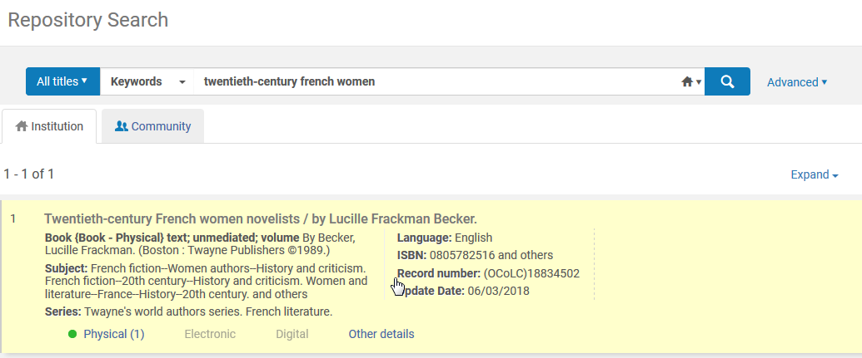
Purchase request "Use existing record"
Option 2 example
He searches for and finds the "similar" record and selects it

Slide 42
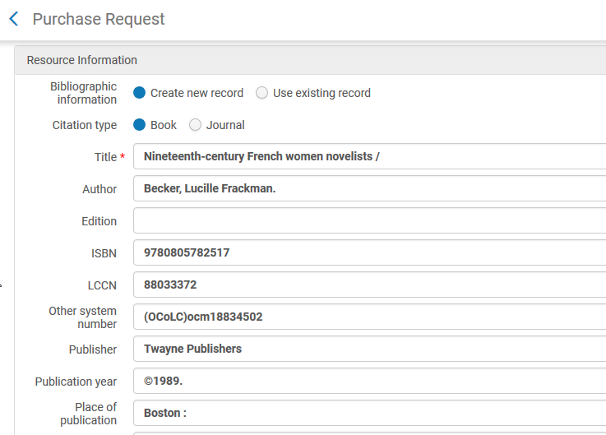
Purchase request "Use existing record"
Option 2 example
Now in the purchase request he selects "Create new record". All fields become editable and he changes only what must be changed.

Slide 43
Topics
Staff roles - assigning owning library
Staff roles – handling purchase requests
Determination of purchase request type
Purchase request "Use existing record"
Purchase request "Use existing record" - option 1
Purchase request "Use existing record" - option 2
Purchase request task list
Purchase request Primo form customization
Purchase request deletion from Primo library card
User level "Purchase request library"
Relink Purchase Request to different record
Define Purchase Request match method

Slide 44
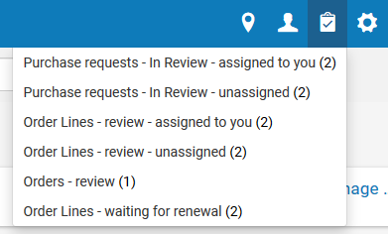
Purchase request task list
The task list includes only "In Review" purchase requests.
This creates an efficient process for the end user.

Slide 45
Topics
Staff roles - assigning owning library
Staff roles – handling purchase requests
Determination of purchase request type
Purchase request "Use existing record"
Purchase request "Use existing record" - option 1
Purchase request "Use existing record" - option 2
Purchase request task list
Purchase request Primo form customization
Purchase request deletion from Primo library card
User level "Purchase request library"
Relink Purchase Request to different record
Define Purchase Request match method

Slide 46
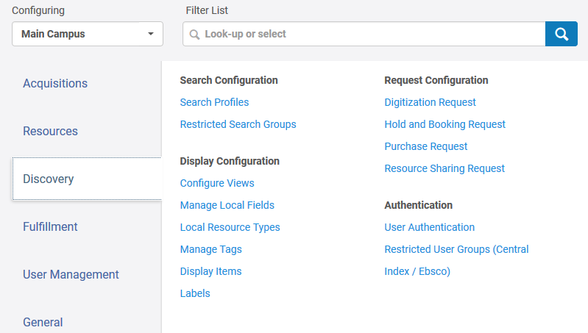
Purchase request Primo form customization
It is possible to configure the Purchase Request form which appears to the end user in Primo.
Here we will access it from the discovery configuration menu

Slide 47
Purchase request Primo form customization
On the next slide we see that by using the "Display to Public" column we can determine which fields the end user will have. We are defining that the end user will only have five fields:
Title
Author
Publisher
Year
Place
Other fields such as ISBN, Volume, and lccNumber will not appear.

Slide 48
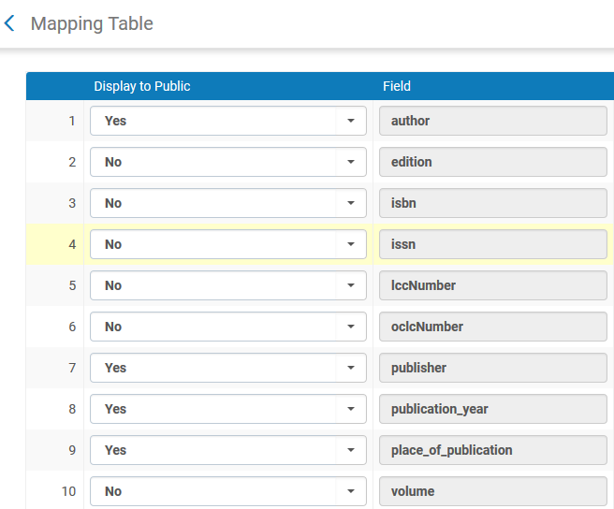
Purchase request Primo form customization

Slide 49
Purchase request Primo form customization
On the next slide we see that when the end user fills out a Purchase request in Primo they see only the fields which have been defined to display to the public.

Slide 50
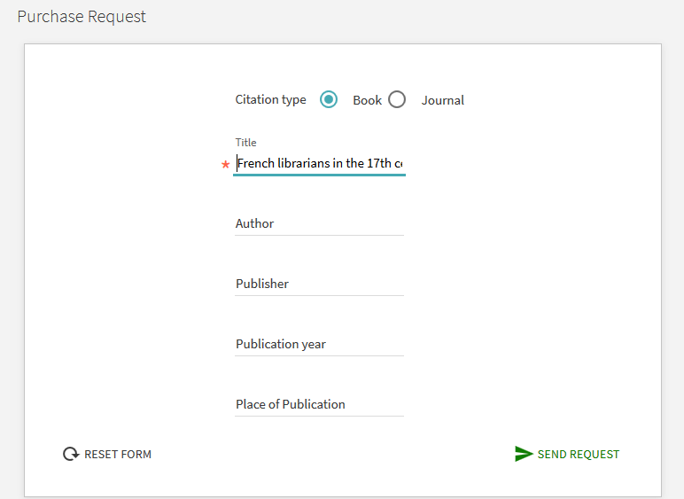
Purchase request Primo form customization

Slide 51
Topics
Staff roles - assigning owning library
Staff roles – handling purchase requests
Determination of purchase request type
Purchase request "Use existing record"
Purchase request "Use existing record" - option 1
Purchase request "Use existing record" - option 2
Purchase request task list
Purchase request Primo form customization
Purchase request deletion from Primo library card
User level "Purchase request library"
Relink Purchase Request to different record
Define Purchase Request match method

Slide 52
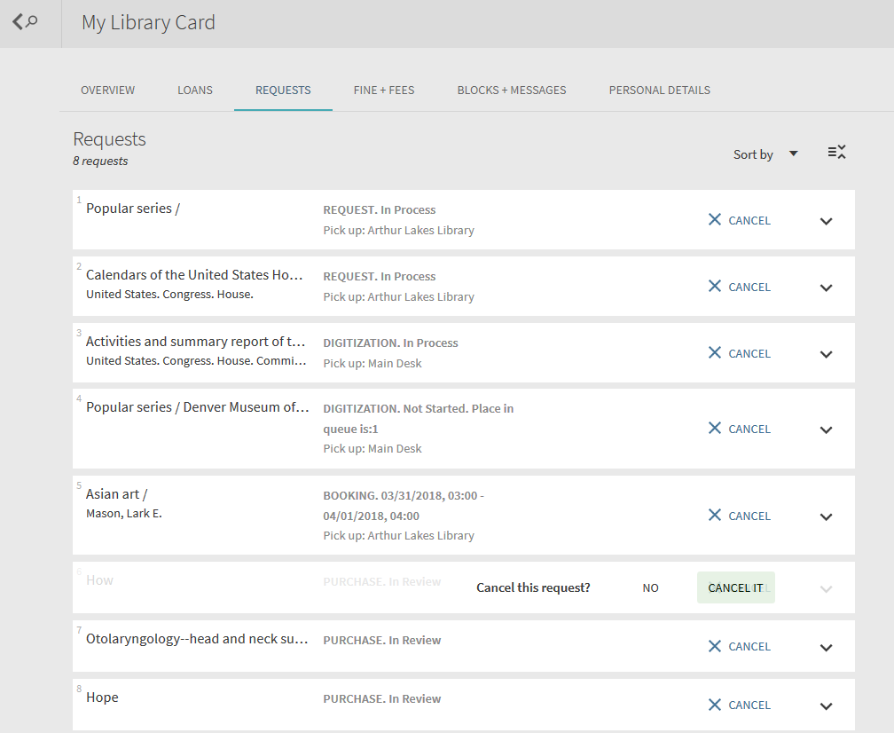
Purchase request deletion from Primo library card
It is possible for the end user to delete their purchase request via the Primo library card

Slide 53
Topics
Staff roles - assigning owning library
Staff roles – handling purchase requests
Determination of purchase request type
Purchase request "Use existing record"
Purchase request "Use existing record" - option 1
Purchase request "Use existing record" - option 2
Purchase request task list
Purchase request Primo form customization
Purchase request deletion from Primo library card
User level "Purchase request library"
Relink Purchase Request to different record
Define Purchase Request match method

Slide 54
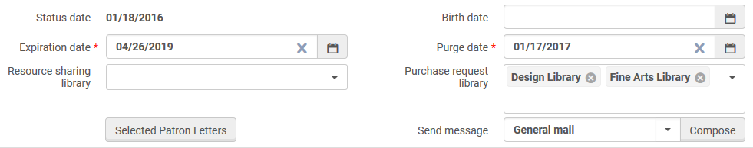
User level "Purchase request library"
On the level of the user record there is a field "Purchase request library"

Slide 55
User level "Purchase request library"
When a patron makes a purchase request or when a staff user makes a purchase request on behalf of the patron then:
If the patron has no "purchase request library" then any library can be the owning library of the purchase request.
If the patron does have one or more "purchase request libraries" then only those libraries can be the purchase request owning libraries.

Slide 56


User level "Purchase request library"
For example:
Patron Mary Jones has more "purchase request libraries" Design Library and Fine Arts Library
Patron John Smith has no "purchase request libraries" then only those libraries can be the purchase request owning libraries.

Slide 57
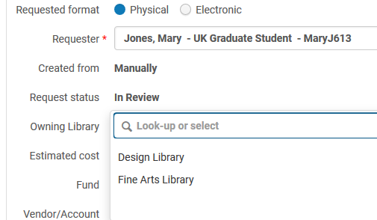
User level "Purchase request library"
When purchase request is made for Mary Jones only the Design Library and Fine Arts Library can be the owning library of the purchase request

Slide 58
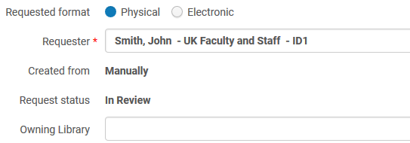
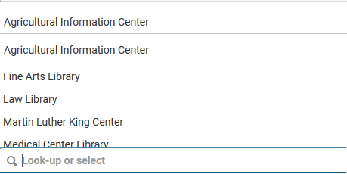
User level "Purchase request library"
When purchase request is made for John Smith then any library can be the owning library of the purchase request

Slide 59
Topics
Staff roles - assigning owning library
Staff roles – handling purchase requests
Determination of purchase request type
Purchase request "Use existing record"
Purchase request "Use existing record" - option 1
Purchase request "Use existing record" - option 2
Purchase request task list
Purchase request Primo form customization
Purchase request deletion from Primo library card
User level "Purchase request library"
Relink Purchase Request to different record
Define Purchase Request match method

Slide 60
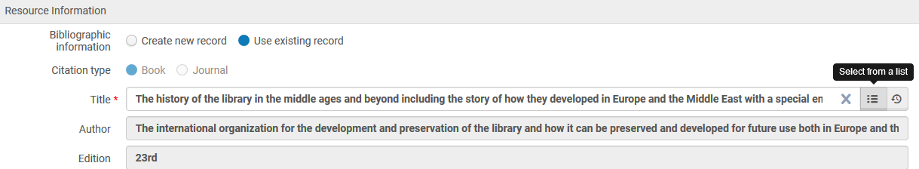
Relink Purchase Request to different record
It is possible to relink a Purchase Request to a different bibliographic record.
When doing "edit" on an existing purchase request there is an option to search for another title from the title pickup list.
After choosing the "new" bibliographic record the bibliographic information in the purchase request will get updated.
This is possible to do at all stages before the purchase request is approved (for example when it is in review).

Slide 61
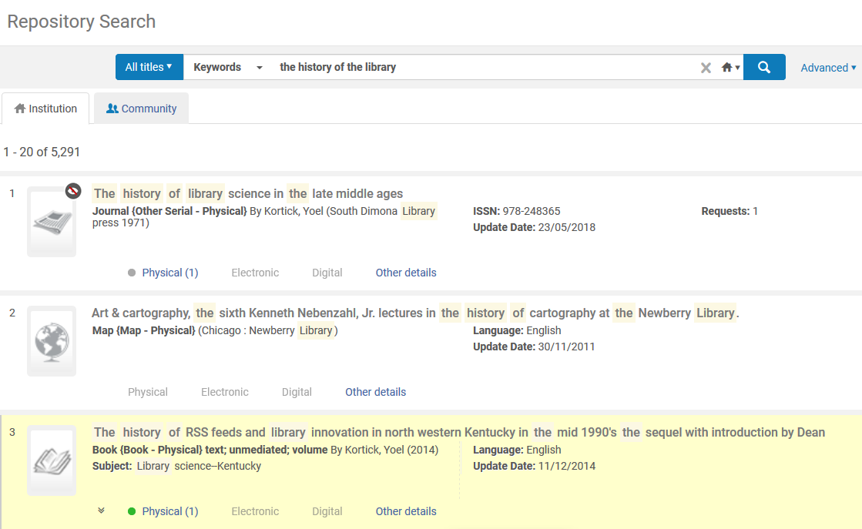
Relink Purchase Request to different record
Now we are going to choose a different bibliographic record

Slide 62
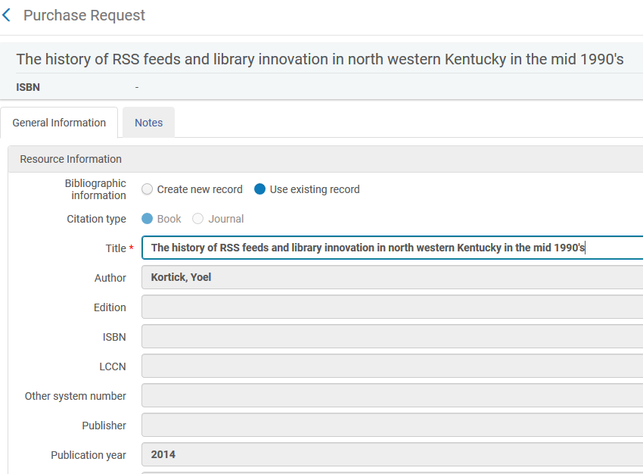
Relink Purchase Request to different record
The same purchase request is now linked to the new bibliographic record

Slide 63
Topics
Staff roles - assigning owning library
Staff roles – handling purchase requests
Determination of purchase request type
Purchase request "Use existing record"
Purchase request "Use existing record" - option 1
Purchase request "Use existing record" - option 2
Purchase request task list
Purchase request Primo form customization
Purchase request deletion from Primo library card
User level "Purchase request library"
Relink Purchase Request to different record
Define Purchase Request match method

Slide 64
Define Purchase Request match method
There is a parameter to define what parameters will be used when matching a new purchase request. This is instead of the current hard coded match on ISSN or ISBN.
The parameter is in the configuration menu “acquisitions > other settings” and is called purchase_request_import_profile
When a purchase request is made Alma looks at this import profile and use the match routine from there.
It will also use the import profile definition to create the record in the network zone or institution zone (in the case of a consortium).

Slide 65
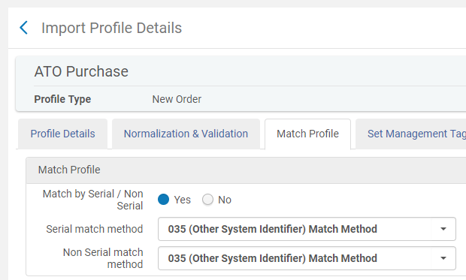
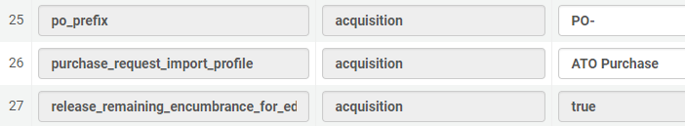
Define Purchase Request match method
Here we have an import profile called ‘ATO Purchase’ which matches in the 035, and it is defined in ‘other settings”

Slide 66
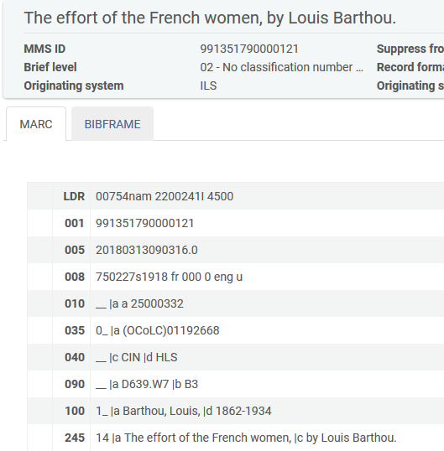
Define Purchase Request match method
In the repository we have MMSID 991351790000121 “The effort of French women” which has 035 $$a (OCoLC)01192668

Slide 67
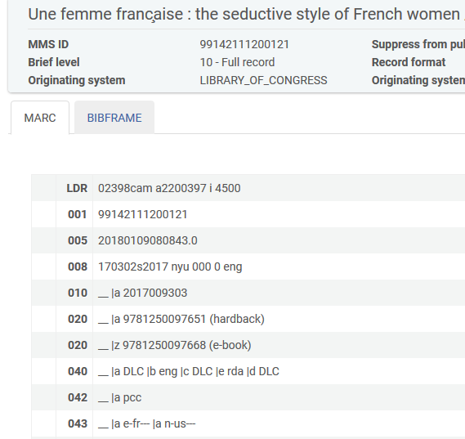
Define Purchase Request match method
We also have MMSID 99142111200121 “Une femme française” which has 020 $$a 9781250097651 (hardback)

Slide 68
Define Purchase Request match method
If we create a record with both
020 $$a 9781250097651 (hardback)
035 $$a (OCoLC)01192668
Then it should link to the record with the 035 and not to the record with the 020
This is because we defined to use an import profile which matches on the 035.

Slide 69
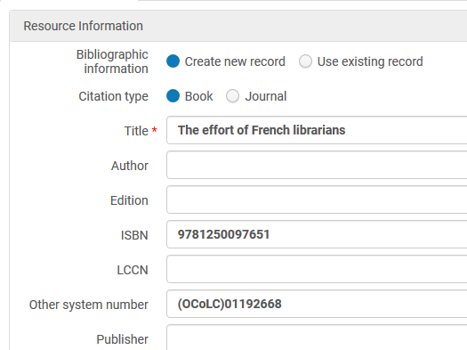
Define Purchase Request match method
Here is a new purchase request with an ISBN and a 035, both of which exist in different records in the repository

Slide 70
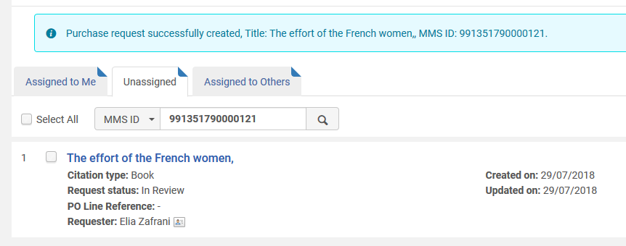
Define Purchase Request match method
The purchase request gets created and we see that it matches MMSID 991351790000121 “The effort of French women” which has 035 $$a (OCoLC)01192668

Slide 71
Define Purchase Request match method
It is correct that it linked to MMSID 991351790000121 “The effort of French women” which has 035 $$a (OCoLC)01192668
It should not have linked to MMSID 99142111200121 “Une femme française” which has 020 $$a 9781250097651 (hardback)
This is because the import profile matches on 035 and not 020

